Slide 1
AIR POLLUTION
Air pollution is contamination of the indoor or outdoor environment by any chemical , physical or biological agent that modifies the natural characteristics of the atmosphere.

Slide 2
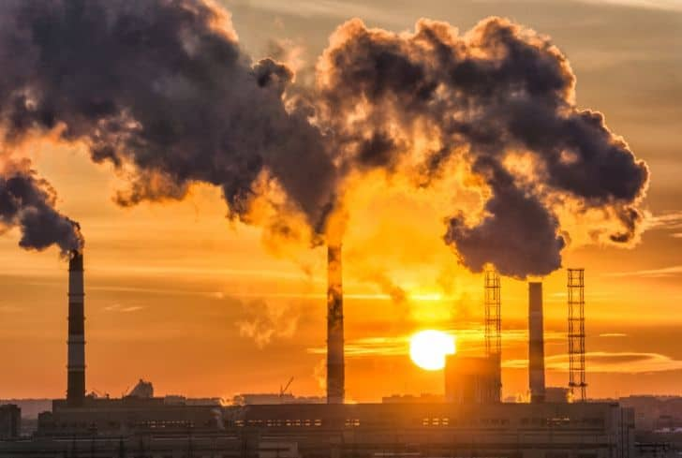
Smoke that causes effect on environment

Slide 3
IMPACT ON ENVIRONMENT
It causes harmful effects on human respiratory system .
It damages heart, lungs, causes cancer , asthama.

Slide 4
EFFECTS OF AIR POLLUTION
Reaspiratory and Heart problems .
Global Warming
Acid Rain
Eutrophication
Effects on Wildlife
Depletion of ozone layer

Slide 5
CONCLUSION
While the effects of air pollution on material , vegetation and animal can be measures , health effects on humans can only be estimated from epidemiological evidence.

